Slide 1
Virat Kholi
By Jai Krishna Gupta

Slide 2
Agenda
When growing up
His start to his courir
RCB!!!
The king of the IPL
India Captain
As present

Slide 3
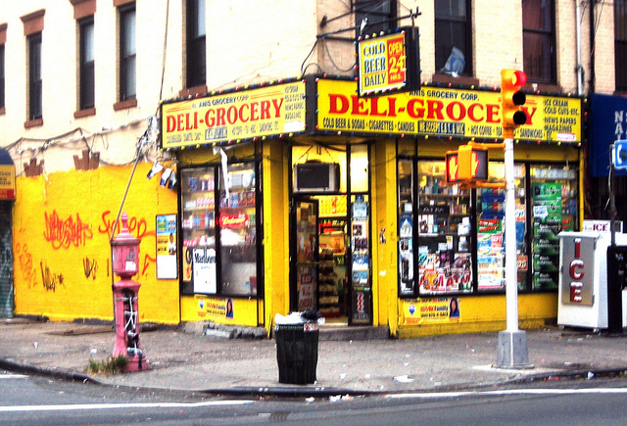
When GroWIng up
He Grew up in New Deli in India
He was born 5 November 1988

Slide 4
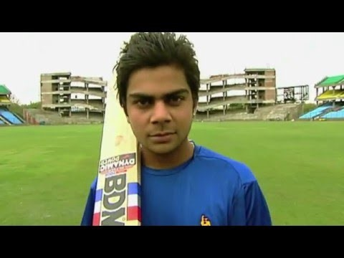
His start to his courir

Slide 5
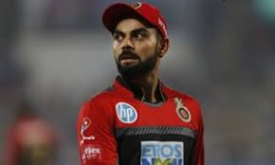
RCB!!!
After a good start to his courier he made the IPL

Slide 6

The king of the IPL
This is how it all happened

Slide 7
The captain of India
After the great Dhoni came the great Kholi

Slide 8
As present
The greatest player of all time

Slide 9
Thank you

